Slide 1
Predicting Online News Popularity: Analysis of Articles Published on Mashable
Sarbottam Bhagat, Abhijeet Kumar, Brooke Woods, Kevin Kim, Sai Rohith
Doctoral Group I
DSCI 5240
University of North Texas

Slide 2
Contents
Project Overview and Problem Statement
Study Objectives
Evaluation Criteria/Metrics
Data Description, Exploration and Preprocessing
Algorithms and Techniques Description
Implementation
Results
Managerial Implications
Limitations

Slide 3
Project Overview and Problem Statement
Online news is an integral part of our daily lives.
The production and consumption of online news, easy accessibility to the internet and cross platform integration.
Popularity depends on theme, content, contemporariness, writing quality, and other latent factors.
However, not all online news become equally popular.
Popularity prediction before publication will allow content creators, journalists, editors and advertising agencies up their game.

Slide 4
Study Objectives
To explore the variables which may affect online news popularity before publication.
More specifically,
To utilize a list of attributes of the news articles and the best machine learning algorithms to accurately classify the target label (popular / unpopular) of the articles to be published.
To evaluate the performance of machine learning models using different metrics/criteria.

Slide 5
Evaluation Criteria/Metrics
Accuracy
Accuracy is defined as the proportion of correct classification. It can be calculated as,
Accuracy = (true positives + true negatives)/ total instances
Misclassification Rate
Misclassification rate can be defined as the percentage of incorrectly classified instances (Baughman et al., 1995). It can be calculated as,
Misclassification rate = (false positives + false negatives)/total instances
F1-score
F1-score is defined as unweighted measure for accuracy and is calculated as a harmonic mean of precision and recall (Naga Haritha et al., 2019). It can be calculated as,
F1 = (2 x precision x recall) / (precision + recall)
Area Under Curve (AUC)
The AUC refers to the area under the ROC (Receiver Operating Characteristics) curve. ROC curve is a graphical plot of the True Positive Rate versus the False Positive Rate (Hand & David, 2009).

Slide 6
Data Description, Exploration and Preprocessing
39,643 news articles from an online news website called Mashable collected over 2 years from Jan 2013 to Jan 2015.
Downloaded from UCI Machine Learning Repository.
61 attributes; 1 target attribute (number of shares), 58 predictive features and 2 non-predictive features.
The dataset has already been initially preprocessed.
Exploring the data revealed that target variable (shares) and other input variables were highly skewed (see table 1).

Slide 7
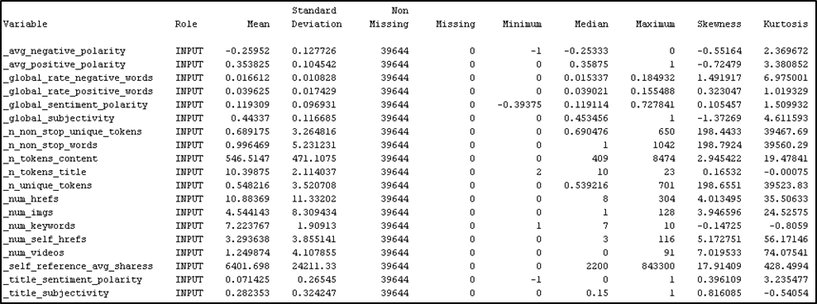


…Data Description, Exploration and Preprocessing
SKEWED
Table 1: Summary statistics of input variables before transformation

Slide 8
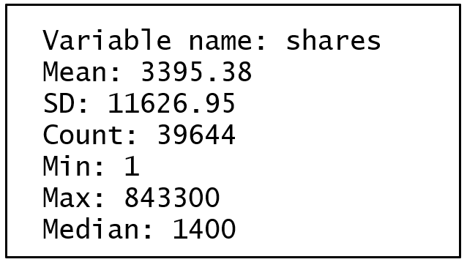
…Data Description, Exploration and Preprocessing
Table 2: Statistics of Target Variable

Slide 9
…Data Description, Exploration and Preprocessing
In order to deal with the skewness in the target variable meaningfully and to discriminate the news as popular vs unpopular
Median of target attribute (1400) was set a threshold.
Continuous target variable into a Boolean label (1 being popular and 0 being unpopular).
Skewed input variables were log transformed in order to keep their skewness between the recommended thresholds of ±3.

Slide 10
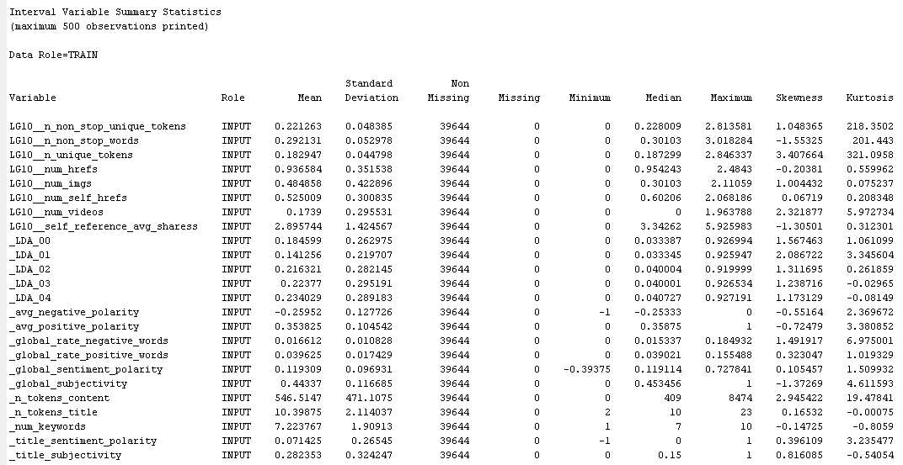
…Data Description, Exploration and Preprocessing
Table 3: Summary statistics of interval variables after transformation

Slide 11
Algorithms and Techniques
Logistic Regression (stepwise)
The advantage of logistic regression is that the training and predicting speed is very fast.
Decision Tree
The objective of analysis is reflected in this root node as a simple, one-dimensional display in the decision tree interface.
Offers variable importance priority table
Neural Network (Auto Neural Network)
Offers variable importance priority table via proxy decision tree node

Slide 12
Implementation
SAS EM Environment
Randomly split or partitioned the dataset into training set (70%), validation set (20%) and testing set (10%)
Model Comparison node in order to observe metrics for classifier evaluation

Slide 13
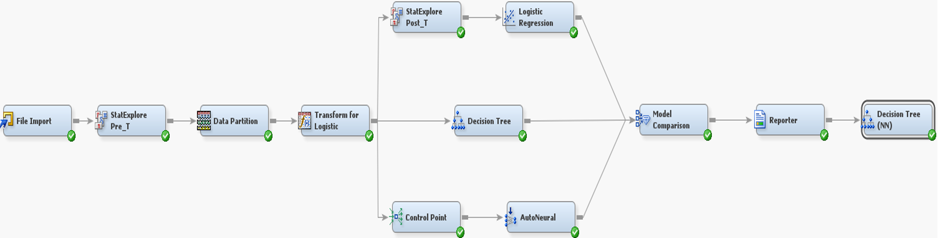
…Implementation
Figure 1: Classifier Implementation in SAS EM

Slide 14
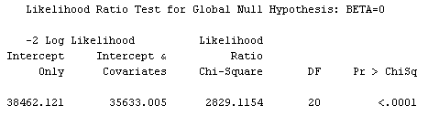
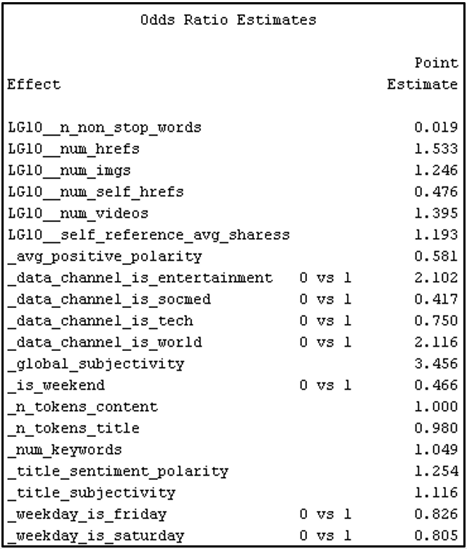
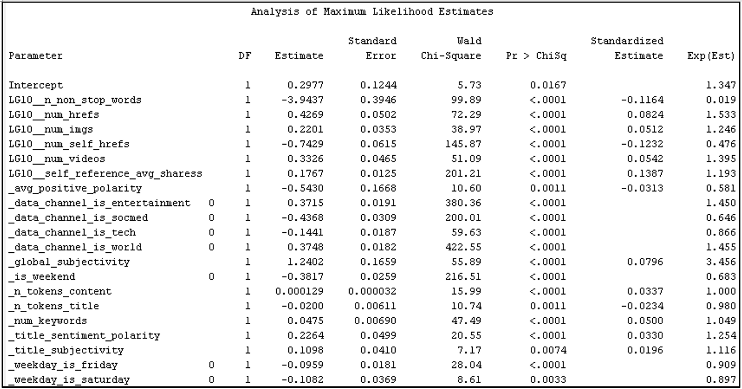
Results
Figure 2: Logistic Regression Output

Slide 15
Results (Logistic Regression)
Effect | Point Estimate
Global_subjectivity (text subjectivity) | 3.456
Channel is world 0 vs 1 | 2.116
Channel is entertainment 0 vs 1 | 2.102
Number of links | 1.533
Num of videos | 1.395
Sentiment Polarity | 1.254
Number of imgages | 1.246
Title Subjectivity | 1.116
Avg shares of referenced articles in Mashable | 1.093
Number of keywords | 1.049
Number of words in content | 1.000
Number of words in the title | 0.980
Weekdays_is_Friday 0 vs 1 | 0.826
Weekdays_is_Saturday 0 vs 1 | 0.805
Channel is tech 0 vs 1 | 0.750
Avg Positive Polarity | 0.581
Number of links to other articles | 0.476
Weekend 0 vs 1 | 0.466
Channel is sound 0 vs 1 | 0.417
Rate of non stop words | 0.019

Slide 16
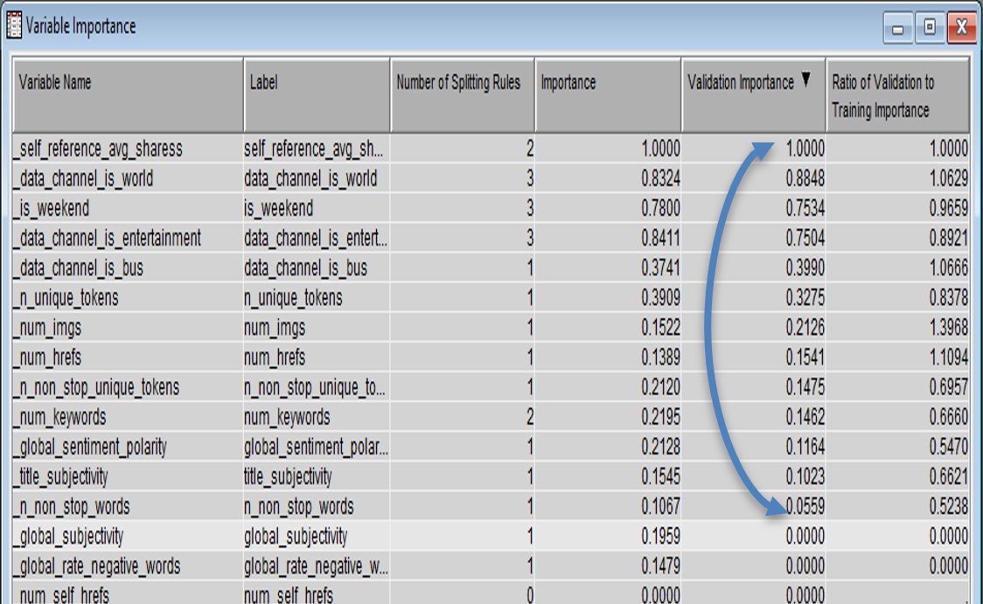
…Results (Decision Tree)
Figure 4: Subtree Assessment Plot for Decision Tree
Figure 3: Variable importance as indicated by Decision Tree

Slide 17
…Results (Decision Tree)
Variable | Validation Importance
Avg shares of referenced articles in Mashable | 1.0000
Channel is world | 0.8848
Weekend | 0.7534
Channel is entertainment | 0.7504
Channel is business | 0.399
Rate of unique words in the content | 0.3275
Number of image | 0.2126
Number of links | 0.1541
Rate of non stop unique token | 0.1475
Number of keywords in metadata | 0.1462
Text sentiment polarity | 0.1164
Text subjectivity | 0.1023
Rate of non-stop words in the content | 0.0559

Slide 18
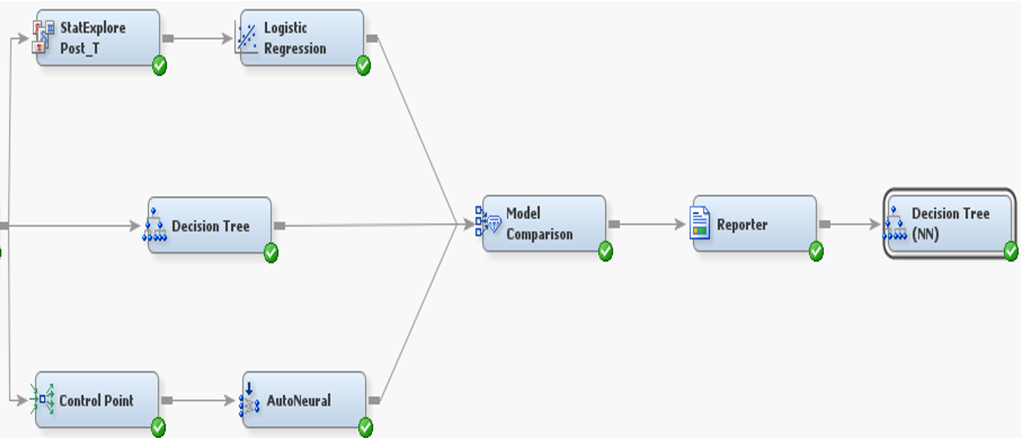
…Results (Neural Network)
Figure 5: Neural Network Workaround

Slide 19
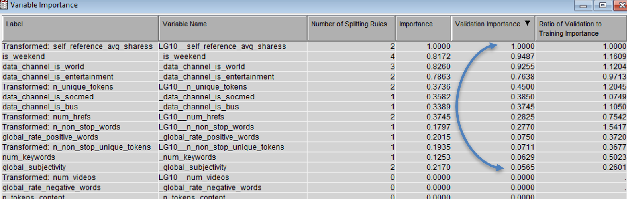
…Results (Neural Network)
Figure 6: Variable importance as indicated by the Neural Network Algorithm

Slide 20
…Results (Neural Network)
Variable | Validation Importance
Avg shares of referenced articles | 1.0000
Weekend | 0.9487
Channel is world | 0.9225
Channel is entertainment | 0.7638
Rate of unique words in the content | 0.4500
Channel is social media | 0.3850
Channel is business | 0.3745
Number of links | 0.2825
Rate of non-stop words in the content | 0.2770
Rate of positive words in the content | 0.0750
Rate of unique non-stop words in the content | 0.0711
number of keywords in the metadata | 0.0629
Text subjectivity | 0.0565

Slide 21
Model Evaluation
Classifier | Accuracy | F1-Score | Misclassification Rate | AUC
Logistic Regression | 0.623 | 0.611 | 0.388 | 0.662
Decision Tree | 0.634 | 0.634 | 0.357 | 0.689
Neural Network | 0.621 | 0.628 | 0.394 | 0.649
Table 3: Metrics score of three classifiers

Slide 22
Test of Model Robustness
Classifier | Accuracy | F1-Score | Misclassification Rate | AUC
Logistic Regression | 0.616 | 0.604 | 0.373 | 0.673
Decision Tree | 0.630 | 0.632 | 0.349 | 0.692
Neural Network | 0.615 | 0.603 | 0.387 | 0.651
Table 3: Metrics score of three classifiers with training to validation to testing set at 62:24:14

Slide 23
Managerial Implication
Offer guidelines to content creators, journalists, editors and advertising agencies to prioritize attributes of online news to gain maximum reach to the audience.
Consider combining two or more of the following attributes before publishing online.
Links to other online news article on the publisher’s homepage
Links to other articles published by Mashable on an article
Images that are relevant to the news article
Videos that support the news content
Relevant and unique keywords in the metadata so the news becomes more visible
Tailor the news offering in popular themes such as Entertainment, Social Media, Tech and World
Publishing the article either on Friday or weekends
Titles and excerpts that resonate positive polarity and subjectivity with the readers.

Slide 24
Limitations and Improvement Going Forward
Not able to achieve the same level of performance as the dataset donors’ original work.
Areas of improvement
Increasing the size of dataset, allowing decision tree to demonstrate better performance prediction since it has a strong learning capability.
Adding more relevant attributes to the original dataset.
Using all the texts in news articles, break them into words and implement Naive Bayes algorithm.

Slide 25
Thank You ☺

